Slide 1
CERTIFIED DATA SCIENTIST
PEOPLE INFORMATION TECHNOLOGY PROGRAM
Lecture 02
Muhammad Nabeel Ibrahim Khan
NED University of Engineering and Technology

Slide 2
Agenda
Importance of Projects in the Data Science Journey
Introduction to Datasets

Slide 3
Why Projects Matter in Your Data Science
Theoretical knowledge is important, but real learning happens when you apply that knowledge to projects.
Projects provide tangible proof of skills for potential employers or clients.
Projects expose you to real-world data problems, helping you build critical thinking and problem-solving skills.
Projects allow you to experience the complete data science pipeline, from data collection to model deployment.

Slide 4
Types of Projects to Work On
Beginner Projects: Start with simple datasets (e.g., Iris dataset, Titanic dataset).
Intermediate Projects: Work on real-world datasets involving significant data cleaning and feature engineering (e.g., Kaggle competitions).
Advanced Projects: Build end-to-end projects that include deployment, automation, and monitoring (e.g., fraud detection system, recommendation engine).

Slide 5
What is a Dataset?
A dataset is a collection of data. It can contain rows and columns, where:
  Rows represent individual observations or records (e.g., a customer, a transaction, a plant species).
  Columns represent attributes or features of those observations (e.g., name, age, height, species).
Types of Datasets:
  Structured Data: Organized in rows and columns, such as spreadsheets or CSV files (e.g., Iris dataset).
  Unstructured Data: Unorganized in a predefined way, such as images, videos, and text (e.g., raw social media posts).

Slide 6
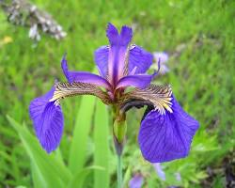
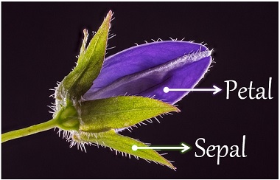
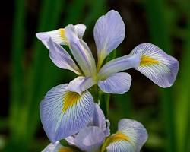
Example Dataset
Iris Dataset: Contains data about Iris flowers species.
Data for each flower includes columns like: "Sepal Length", "Sepal Width", "Petal Length", “Petal Width” and "Species"
Iris Setosa
Iris Virginica

Slide 7
Example Dataset (Cont’d)
Iris dataset is considered beginner-friendly for several reasons:
  The dataset contains only 150 instances, making it easy to load and manipulate.
  There are only four features (sepal length, sepal width, petal length, and petal width), simplifying analysis and visualization.
  The three species are relatively well-separated, making it easier to build accurate models.
  The dataset is widely used and well-documented, with plenty of resources available online.
  There are no missing values, eliminating the need for data cleaning or imputation.
Iris Virginica

Slide 8
Example Dataset (Cont’d)
Sample data in Iris dataset
S. No. | sepal length (cm) | sepal width (cm) | petal length (cm) | petal width (cm) | species
0 | 6.1 | 3.0 | 4.9 | 1.8 | 2
1 | 4.7 | 3.2 | 1.3 | 0.2 | 0
2 | 6.0 | 2.9 | 4.5 | 1.5 | 1
3 | 5.1 | 3.8 | 1.6 | 0.2 | 0
4 | 4.6 | 3.4 | 1.4 | 0.3 | 0

Slide 9

Group Activity – Brainstorming Project Ideas
Think of a simple data science project.
What problem does the model solve?
How will the user interact with it?
How will you deploy the model?

